Slide 1


Learning The Structure of Probabilistic Sentential Decision Diagrams
Yitao Liang, Jessa Bekker, Guy Van den Broeck
August 12, 2017

Slide 2

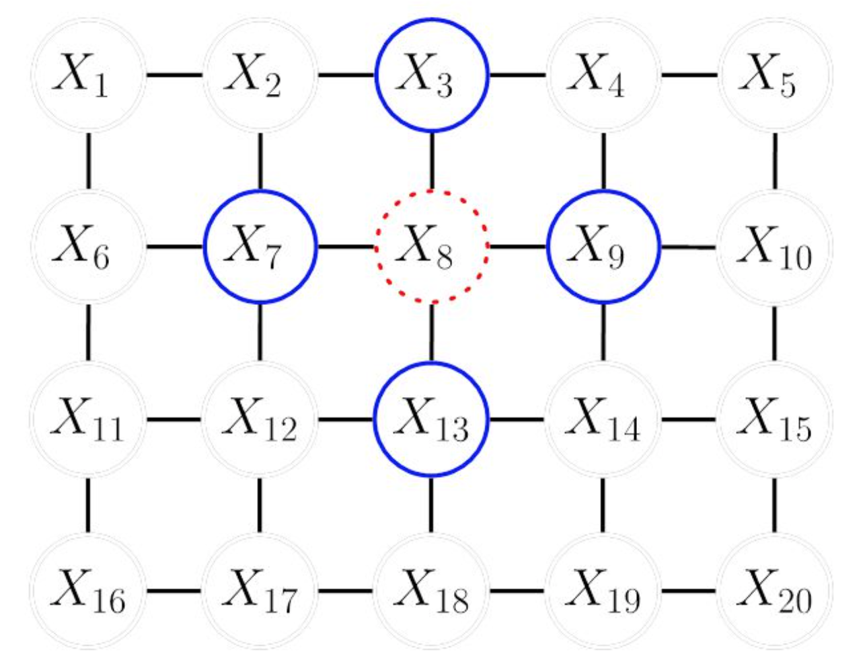
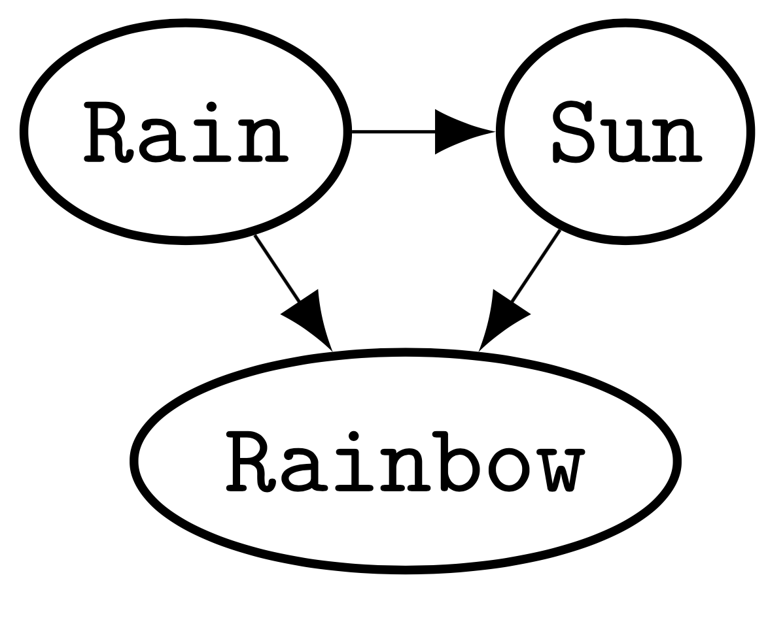
Background: Intractable Representation
Bayesian networks
Markov networks
Do not support linear-time exact inference
Notes:
In order to assess how good those models are, we run them on density estimation datasets. Those achieving a higher log likelihood score are deemed as better

Slide 3
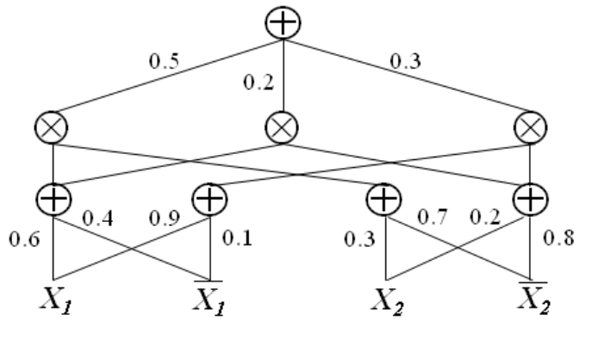
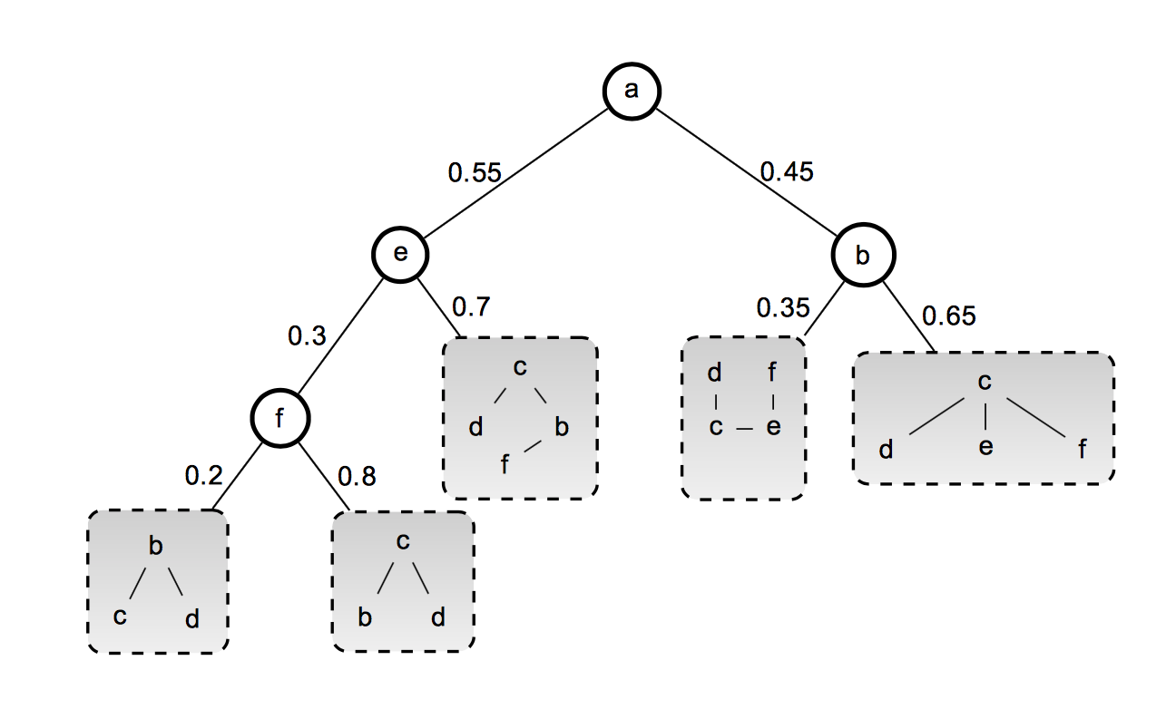
Background: Tractable Representation
Historically: Polytrees, Chow-Liu trees, etc.
SPNs
Cutset Networks
Both are Arithmetic Circuits (ACs)

Slide 4
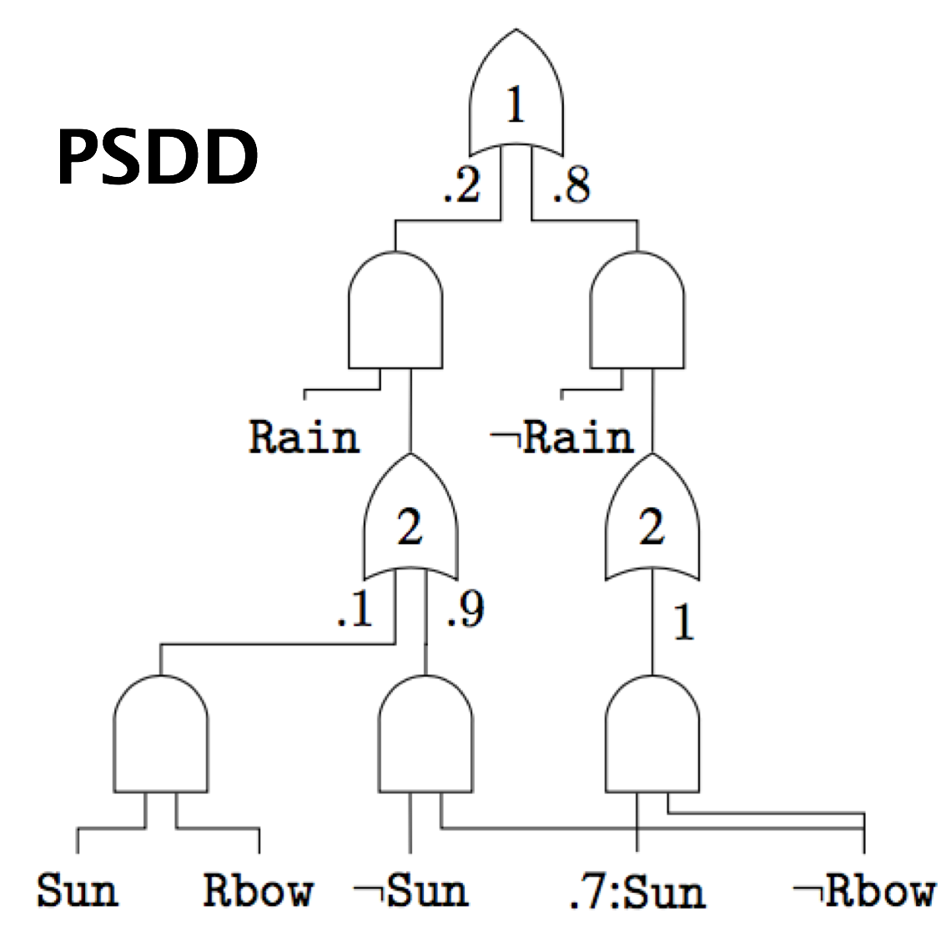
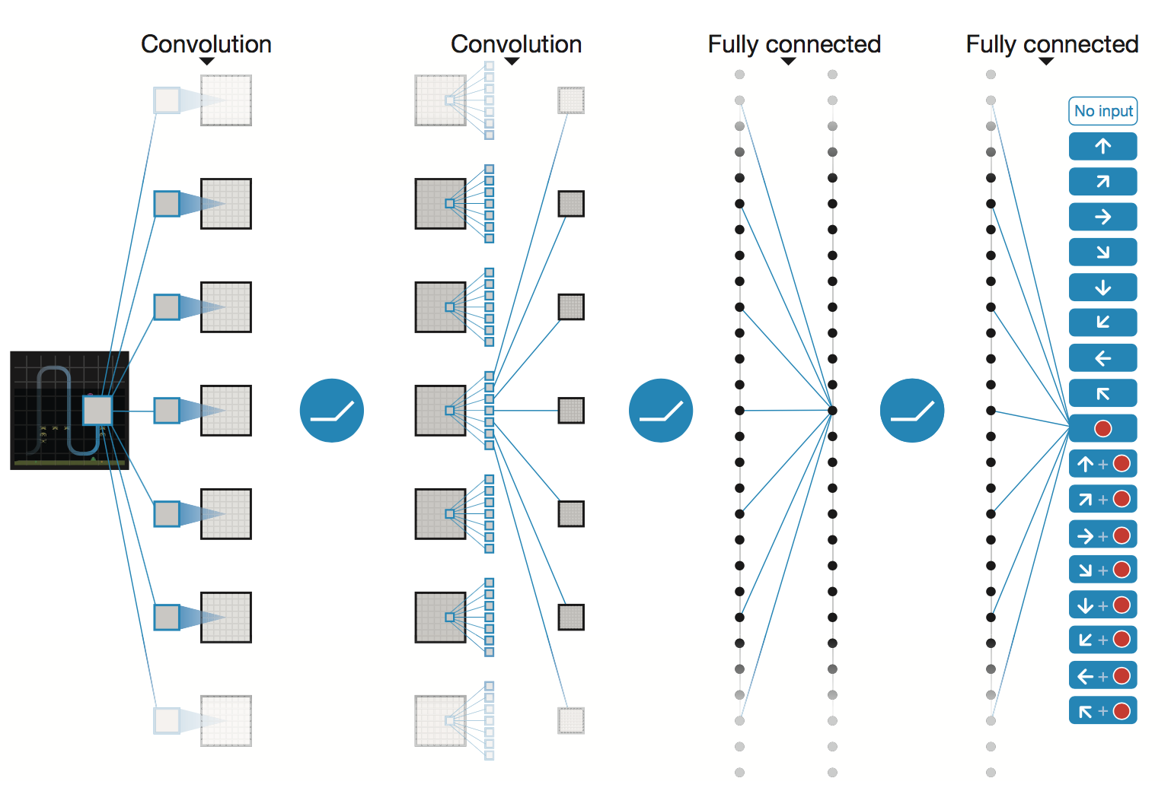
Probabilistic Sentential Decision Diagrams
DNN
SPN
Cutset
Strong Properties
Representational Freedom
Perhaps the most powerful circuit proposed to date
Notes:
When choosing which model to use for a specific machine learning problem, we usually face the tradeoff between choosing a model with a lot of representational freedom or a model with many desirable properties

Slide 5
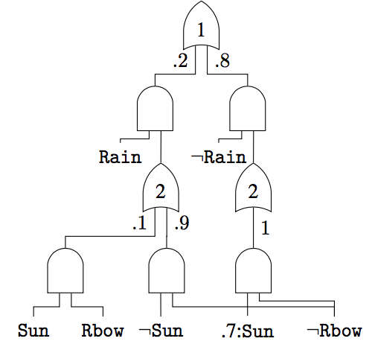


Probabilistic Sentential Decision Diagrams
Linear MPE inference
Linear conditional marginals
Efficient multiplication
Closed-form parameter estimation
Etc.
Structure learning
Notes:
Properties give tractability -> more tasks -> structure learning

Slide 6
What is a PSDD
Bottom-up
each node is a distribution

Slide 7
What is a PSDD
Multiply independent distributions

Slide 8
What Is a PSDD
Weighted mixture of lower level distributions
Notes:
PSDDs have more structural properties, and I will introduce them later. Now, I feel these should be enough for you to understand how a PSDD represents a distributions

Slide 9
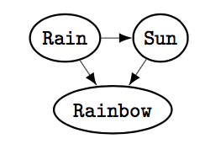
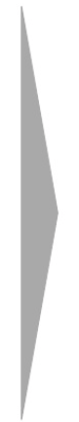
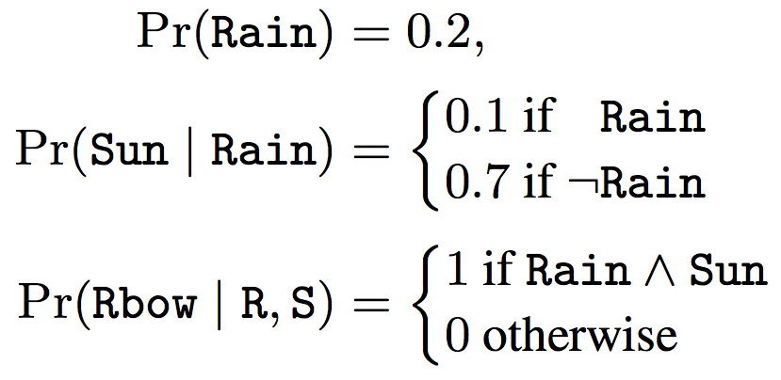
What Does a PSDD Represent

Slide 10

Are PSDDs amenable to tractable structure learning
Notes:
Until here, the time spent needs to be controlled under 5~6 min

Slide 11
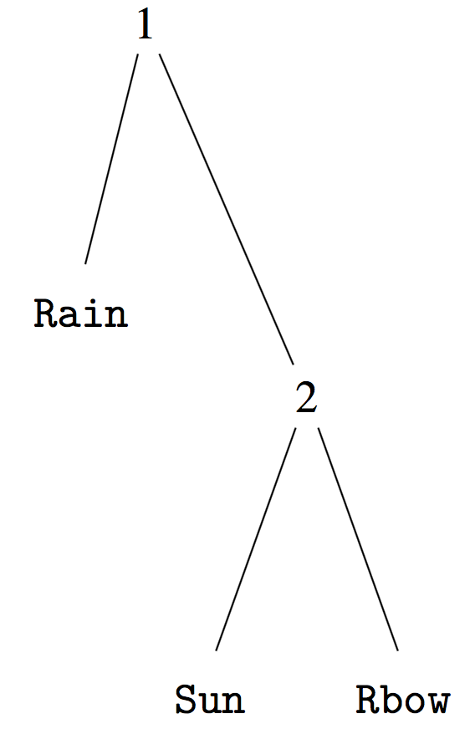


Independence & Variable Tree
Independence
Notes:
Cut the context

Slide 12
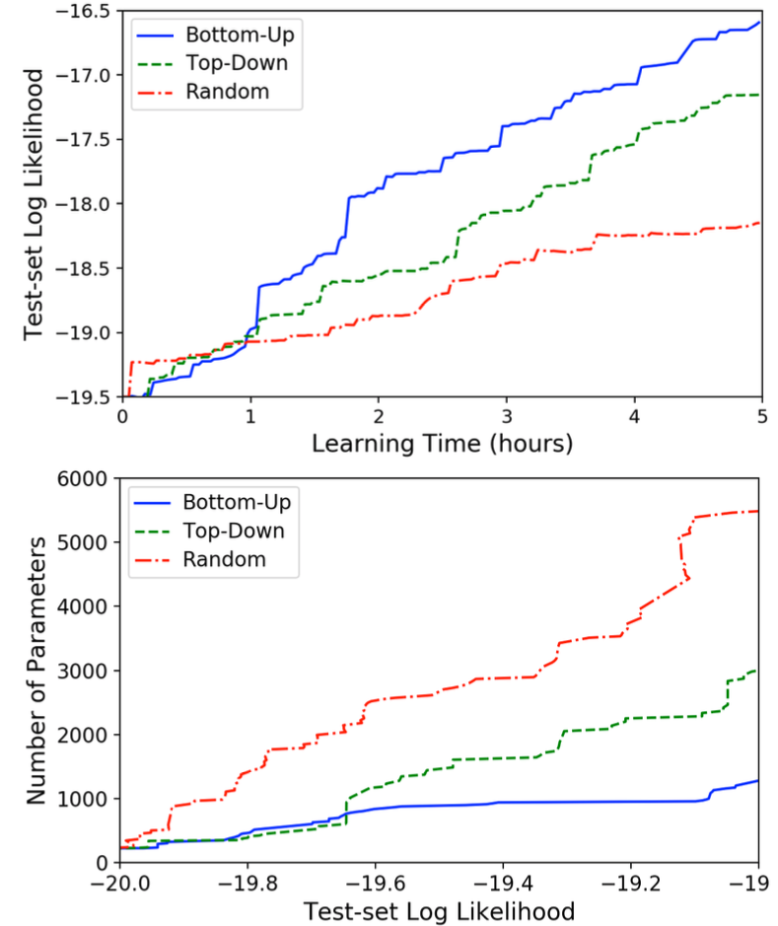
Induce a Vtree from Data
Bottom-up
Induction
Notes:
cluster highly correlated variables

Slide 13

PSDD: Determinism
Branch over sentences on left variables
Notes:
Depending on which sentence is true, the PSDD would go to one and only one branch.
We want to keep the determinism property as it give us the closed-form parameter estimation

Slide 14
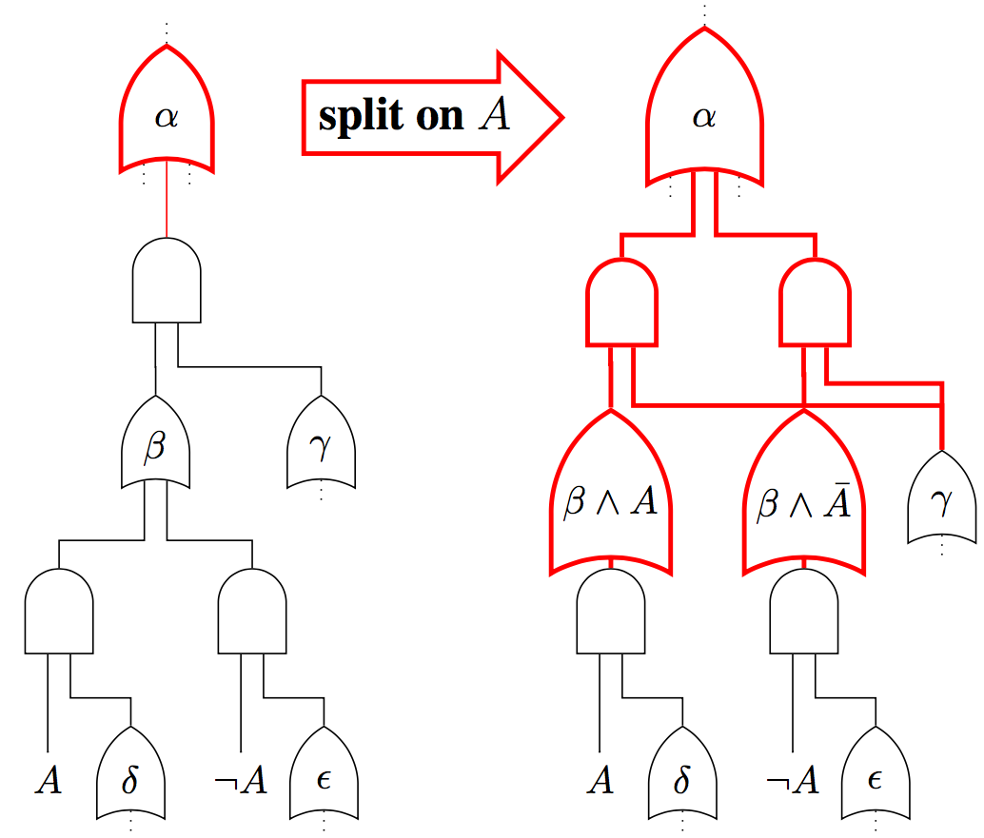
Search for Structure: LearnPSDD Operations
Notes:
add merge
and mention they are universal operations for structure learning
also relate to SPN and Cutset network's structure learning

Slide 15
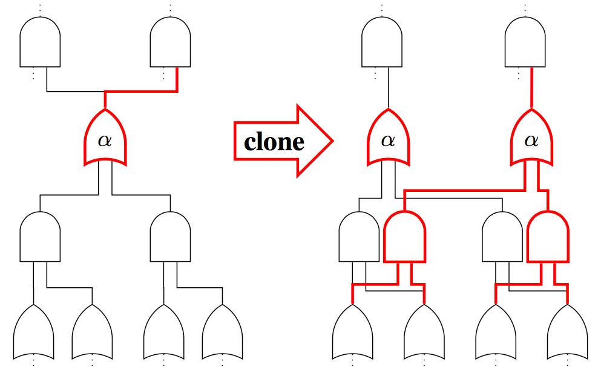
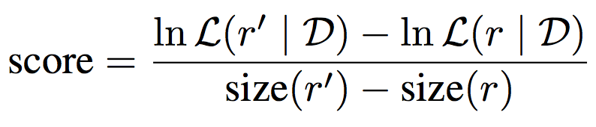
Search for Structure: LearnPSDD Operations
Notes:
add merge
and mention they are universal operations for structure learning
also relate to SPN and Cutset network's structure learning

Slide 16
Learn a PSDD from Data
Roadmap
LearnPSDD
1
Simulate operations
Execute the best
Generate candidate operations
Vtree learning
2
Construct the most naïve PSDD
3
LearnPSDD
(search for better structure)
Notes:
the most naive psdd: fully factorized, assume every variable is independent from one another

Slide 17
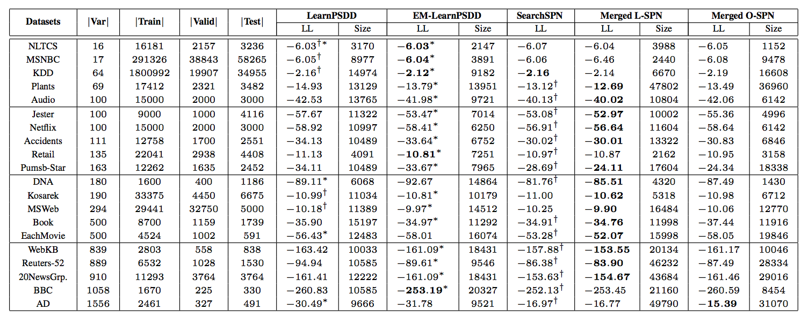
Experiments
Compare with O-SPN: smaller size in 14, better LL in 11,
win on both in 6
Compare with L-SPN: smaller size in 14, better LL in 6,
win on both in 2
Comparable in performance & Smaller in size
Notes:
First introduce the benchmark datasets
make the table readable
Mention 20 datasets

Slide 18
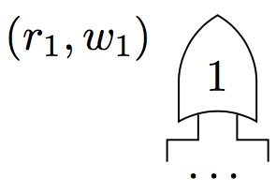
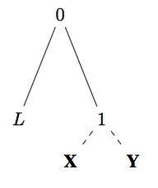
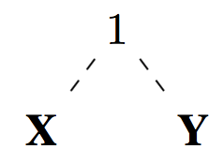
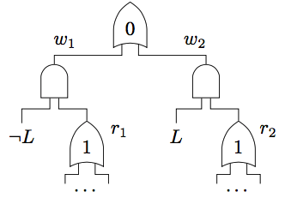
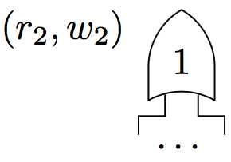
Ensembles of PSDDs
EM/Bagging

Slide 19
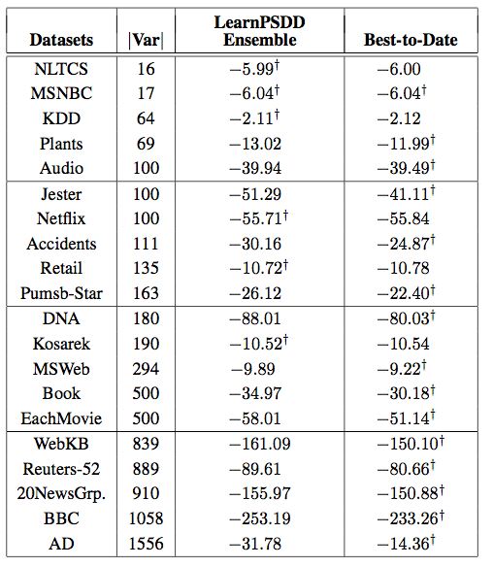
State-of-the-Art Performance
State-of-the-art in 6 datasets
Notes:
red circle the datasets you did better
We compare with 7 most recent learners in this area

Slide 20

Retain the ability to fit logically constrained distributions
Notes:
One of the unique edges of psdds
The easiest way to understand constraints is they eliminate some possible examples from the distribution space

Slide 21
Learning in Logically Constrained Domains
Roadmap
1
Compile logic into a SDD
2
Convert to a PSDD:
Parameter estimation
3
LearnPSDD

Slide 22

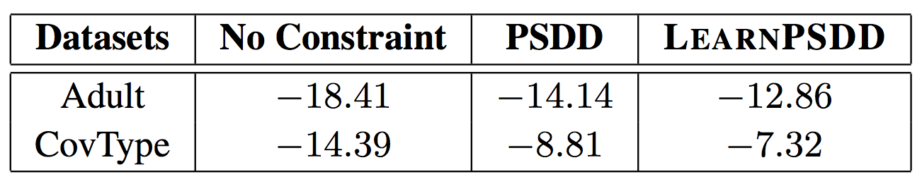
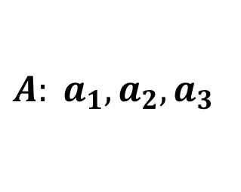
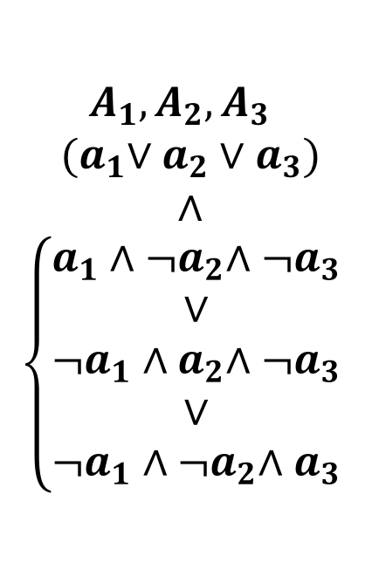
Experiments in Logically Constrained Domains
Discrete multi-valued data
$$A: a_{1}, a_{2}, a_{3}$$
$$A_{1}, A_{2}, A_{3}$$
$${ (a}_{1}∨a_{2}∨a_{3})$$
$$∧$$
$$\left\{\begin{aligned}a_{1}{∧¬a}_{2}∧{¬a}_{3} \\ ∨ \\ ¬a_{1}{∧a}_{2}∧{¬a}_{3} \\ ∨ \\ ¬a_{1}{∧¬a}_{2}∧a_{3}\end{aligned}\right.$$
Never omit domain constraints
Notes:
fix the third constraint
a more concrete constraint example
make up a motivating example

Slide 23
Summary
No constraints
With constraints
1
1
Determine variable
tree
Compile Logics into a SDD
2
2
Construct the most naïve PSDD
Convert to PSDD:
Parameter estimation
3
LearnPSDD
(search for better structure)
3
LearnPSDD
State-of-the-art Performance

Slide 24

Thanks
https://github.com/UCLA-StarAI/LearnPSDD
Notes:
Github link

Slide 25
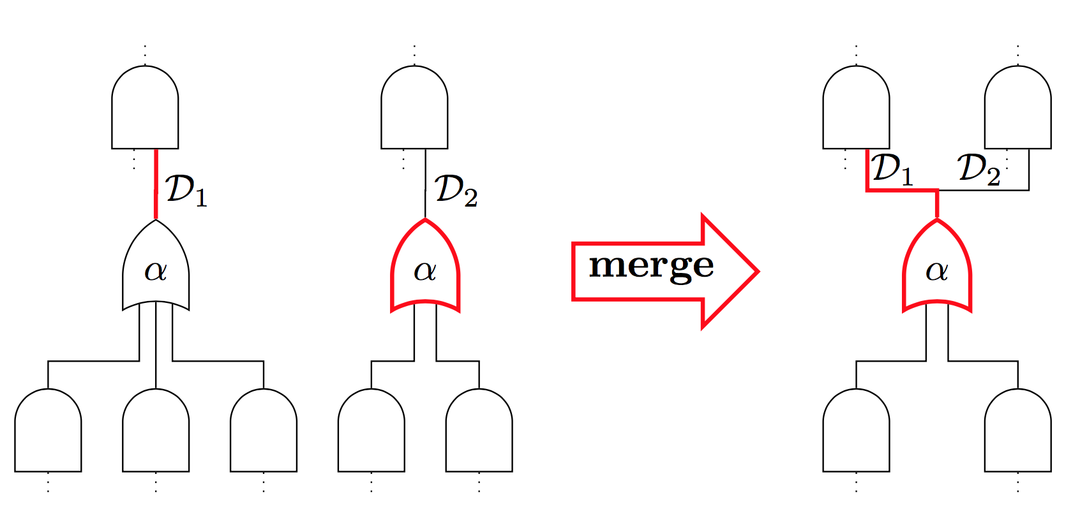
Future Work: Merge
Notes:
add merge
and mention they are universal operations for structure learning
also relate to SPN and Cutset network's structure learning

Slide 26
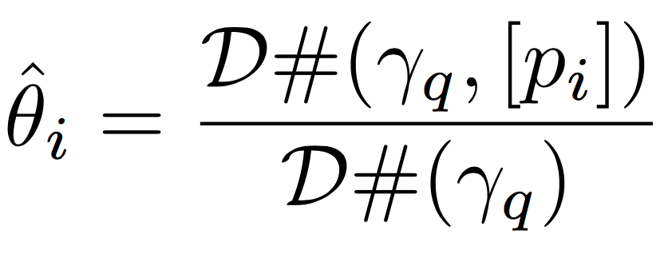
PSDD Parameter Estimation
Closed-form
Notes:
one pass of datasets, similar to what you do in Bayesian networks

Slide 27

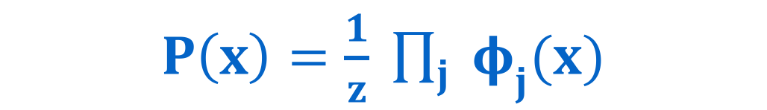
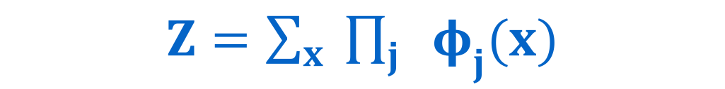
What makes exact inference hard
$P\left(x\right)=\frac{1}{z} \prod_{j}{{ φ}_{j}(x)}$
$Z=\sum_{x}{ \prod_{j}{ { φ}_{j}(x)}}$
Notes:
Depending whether it supports efficient exact inference, a representation can be roughly categorized as “tractable” or “intractable” model.

